Slide 1

Welcome the Protocol Presentation
Presented by:
Mohammad Saydul Hoque
Master of Public Health
ID-190302030010
Department of Public Health
North East University Bangladesh

Slide 2
“Knowledge and practice of Newly Married Couples regarding family planning method in Sylhet”.
Title-

Slide 3
Introduction
A newly married is a person who's recently gotten married and time limit with one year is considered. Most of the couple known a little bit on family planning method but most of them don`t know about all modern family planning method (merits & demerits), that`s why due to knowledge gap they were not able to practice in their conjugal life.
Moreover access to information is the barrier & also the commodities un-availability within hand is the factor.
Most of the couple feel shame to discuss with others about family planning knowledge and practice and how he or she adopt, that`s why unwanted pregnancy, low birth weight baby, child mortality, malnutrition is going on.

Slide 4
Problem statement:
According to BDHS-2018, In Sylhet, unmet need is 14% whereas nationally 12%, TFR is 2.6 whereas nationally 2.3, but according to 4th HPNSP TFR need to decrease 2 by 2022, CPR need to increase 62% to 75% by 2022.
Modern method need to increase 44.8% to 60% by 2022 in Sylhet.
In the above statistics, newlywed are directly included in all the factors.
This kind of study was not done an earlier in Sylhet
From this study- we want to find out what is the current knowledge and practice of newly married couple regarding family planning method in Sylhet

Slide 5
Rationale of the research
Why study is required-
(Considering Newly married couple)
1. Identify socio-demographic characteristics.
2. Identity current knowledge on FP method
3. Identity current practice on FP method.
4. Identify types of barrier
5. How way to improve.

Slide 6
Objectives:
General objectives:-
Assess knowledge and practice of Newly Married couple regarding family planning method in Sylhet.
Specific Objective:-
1. Identify socio-demographic characteristics.
2. Identity current knowledge on FP method
3. Identity current practice on FP method.

Slide 7
Methodology
Type of Study: Descriptive Cross-sectional.
Sampling Design- Random Sampling
Number of Upazila- 1. Golapgonj, & 2. Fenchugonj
Study period: Mar-2021 to June-2021

Slide 8
Independent Variables:
Socio demographic variables-
1. Age
2. Sex
3. Religion
5. Occupation
6. Educational qualification
7. Monthly income

Slide 9
Dependent variables-
Knowledge & Practice about FP among newly married- -
1. Identify current knowledge on FP.
2. Identify current practice on FP
3. Source of FP commodities.
4. Interest to use FP
5. Access to identify FP commodities and gather knowledge
6. To identify alternate channel of distribution for FP commodities.

Slide 10
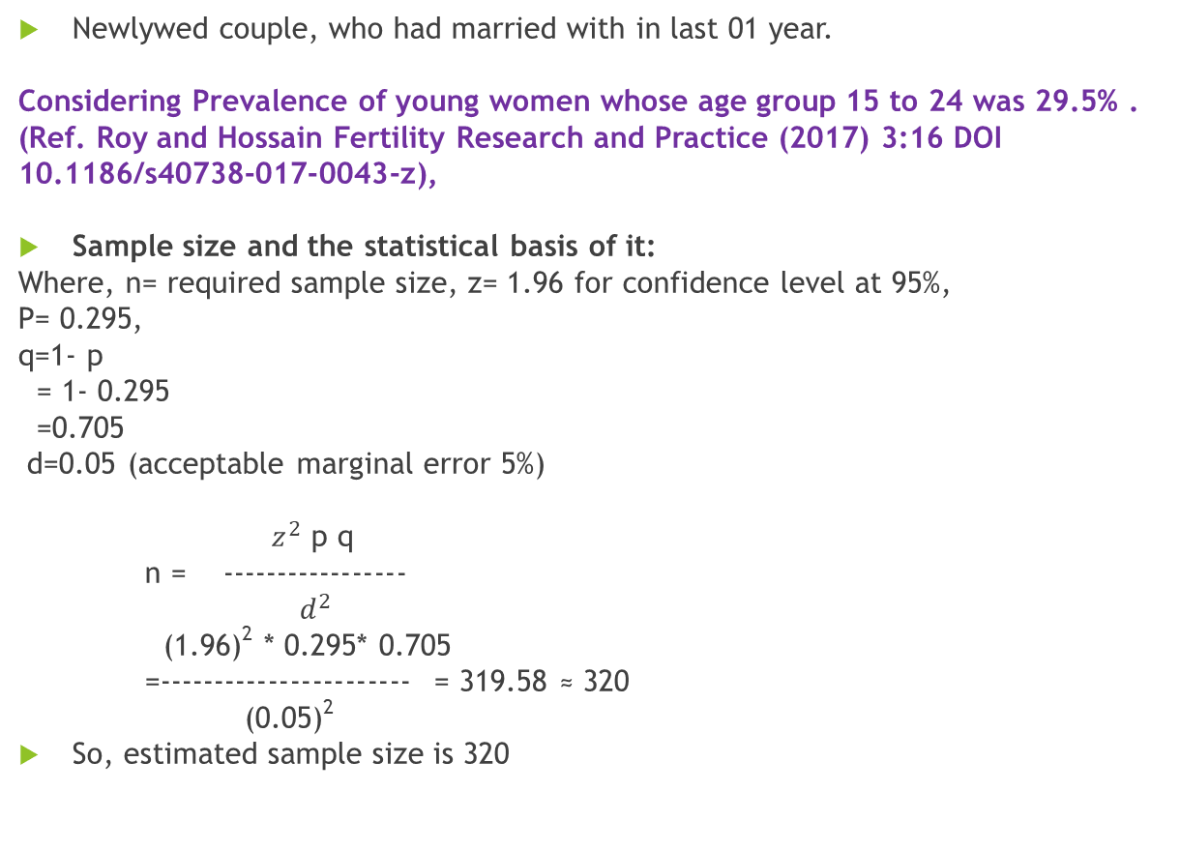
Study population:
Newlywed couple, who had married with in last 01 year.
Considering Prevalence of young women whose age group 15 to 24 was 29.5% .
(Ref. Roy and Hossain Fertility Research and Practice (2017) 3:16 DOI 10.1186/s40738-017-0043-z),
Sample size and the statistical basis of it:
Where, n= required sample size, z= 1.96 for confidence level at 95%,
P= 0.295,
q=1- p
= 1- 0.295
=0.705
d=0.05 (acceptable marginal error 5%)
$z^{2}$ p q
n = -----------------
$d^{2}$
(1.96)² * 0.295* 0.705
=----------------------- = 319.58 ≈ 320
(0.05)²
So, estimated sample size is 320

Slide 11
Criteria for sample selection
Inclusive criteria:-
1. Married within 1 year
2. Those who are willing to participate in the study.
Exclusive criteria:
1. Those who are not willing to participate in the study.
2. Data will not be collected from the person whose are over 1 year of married life.
3. Severely ill person.
4. Mentally disoriented people.

Slide 12
Method of data collection:
Face to face interview.
Permission and purpose of the study will be taken from respondents.
Respondents will be given full assurance on some ethical point of view that under no circumstances any part of the interview will not be disclosed to any unauthorized person.

Slide 13
Research question:
Types of Question- Semi Structured
Demographic & Socio-economic profile-
1. Name of the respondent-
2. Please Indicate your Gender-
A) Male B) Female
3. Please select the category that included in your Age-
A)18-27
B) 28-37
C) 38-47
D) 48 and over.
4. What is your Occupation-
A) Service Holder B) Entrepreneur C) Farmer D) Others

Slide 14
Demographic & Socio-economic profile-
5. Income Range-
A) 10000-20000 B)20001-30000 C) 30000 & Over
6. House hold condition-
A) Raw house B) Tin shed house C) Concrete.
7. Name of spouse-
--------------------------------------------
8. Date of Marriage-
---------------------------------------------

Slide 15
Knowledge
1. What do you think it is necessary to know the contraceptive knowledge
A) Necessary B) Un-necessary,
2. Who should be response for contraception?
Men B) Women C) Both of them have responsibility, D) Both of them without responsibility.
3. The priority consideration of choosing contraceptive methods-
Contraceptive effectiveness, B) The feeling of using contraceptive methods, C) The convenience of buying or using contraceptive tools, D) The safety of contraceptive methods.
4. The side effects of Oral contraceptive pills？(multiple choice)
A) Affecting fertility, B) Affecting the regularity of the menstrual cycle, C) Risk of weight gain, D) Nausea/vomiting, E) No side effects,
5. Which methods can used for emergency contraception？(multiple choice)
A) ECP tablets, B) Intrauterine device C) Vaginal douching, D) Don’t know at all.
6. Whether emergency contraception can substitute for regular contraception？
A) Can, B) Can not , C) Don’t know.
7. Do you think contraceptive method can completely contraception？
A) Can B) Can not C) Don’t know,

Slide 16
Continued-
8. What is benefit of Pill use?
-------------------------------------------
9. What is the benefit of condom use?
------------------------------------------------
10. What is the benefit of Implant use?
------------------------------------------------
11. Which stage of the menstrual cycle most likely to conceive？ A) Menstrual period, B) A few days before or after menstruation C)About 14 days before menstruation, D) Don’t know at all.
12. What is the idol day for starting pill ? A) day-1 of menstruation, B) After 3 day of menstruation, C) after completed menstruation, D) intake only while husband will come.
13. Why required to delay first pregnancy until 20 years of age?
---------------------------------------------------------------------
14. Why required to avoid pregnancy after 35 years of age?
----------------------------------------------------------------------
15. Why birth spacing at least 3 years is required for healthy life?
-----------------------------------------------------------------------
16. Do you know what the benefit of to maintain first 1000 days for healthy and prosperous life of a children?
Yes B) No C) Unknown

Slide 17
PRACTICE
1. How many days later on you have to plan for child?
A) Immediately B) 1-3 years C) 4-5 years
2. Do you discussed with your partner how many children you want to in your conjugal life?
A)1-2 B) 3-4 C) 4 and over
3. Do want to maintain first 1000 days in your life ?
Yes B) No
4. Do you use any FP modern method?
A) Yes B) No
5. If No (why)
--------------------------------------------------------,
6. If Yes
A) Pill B) condom C) Implants,
7. Is your partner well known ?
A) Yes B) No

Slide 18
8. Will you motive any newly married couple for modern FP method?
A)Yes B) No.
9. Which is source of your FP product ?
From Govt. source, B) From private source , C) Pharmacy
D) By Husband
10. How would you like to purchase FP product for use ?
A) From Male B) From Female C) Neighbor
11.How you face barrier for use FP product ?
---------------------------------------------------------------------
12. Any recommendation to reduce barrier FP commodities?
----------------------------------------------------------------------

Slide 19
Thanks for your best cooperation.

